Slide 1

Group - 8
CSCI - 5308
Rent X
Afford More, Own Less
Instructor: Tushar Sharma
TA: Shathish Annamalai
Client : Group – 14

Slide 2
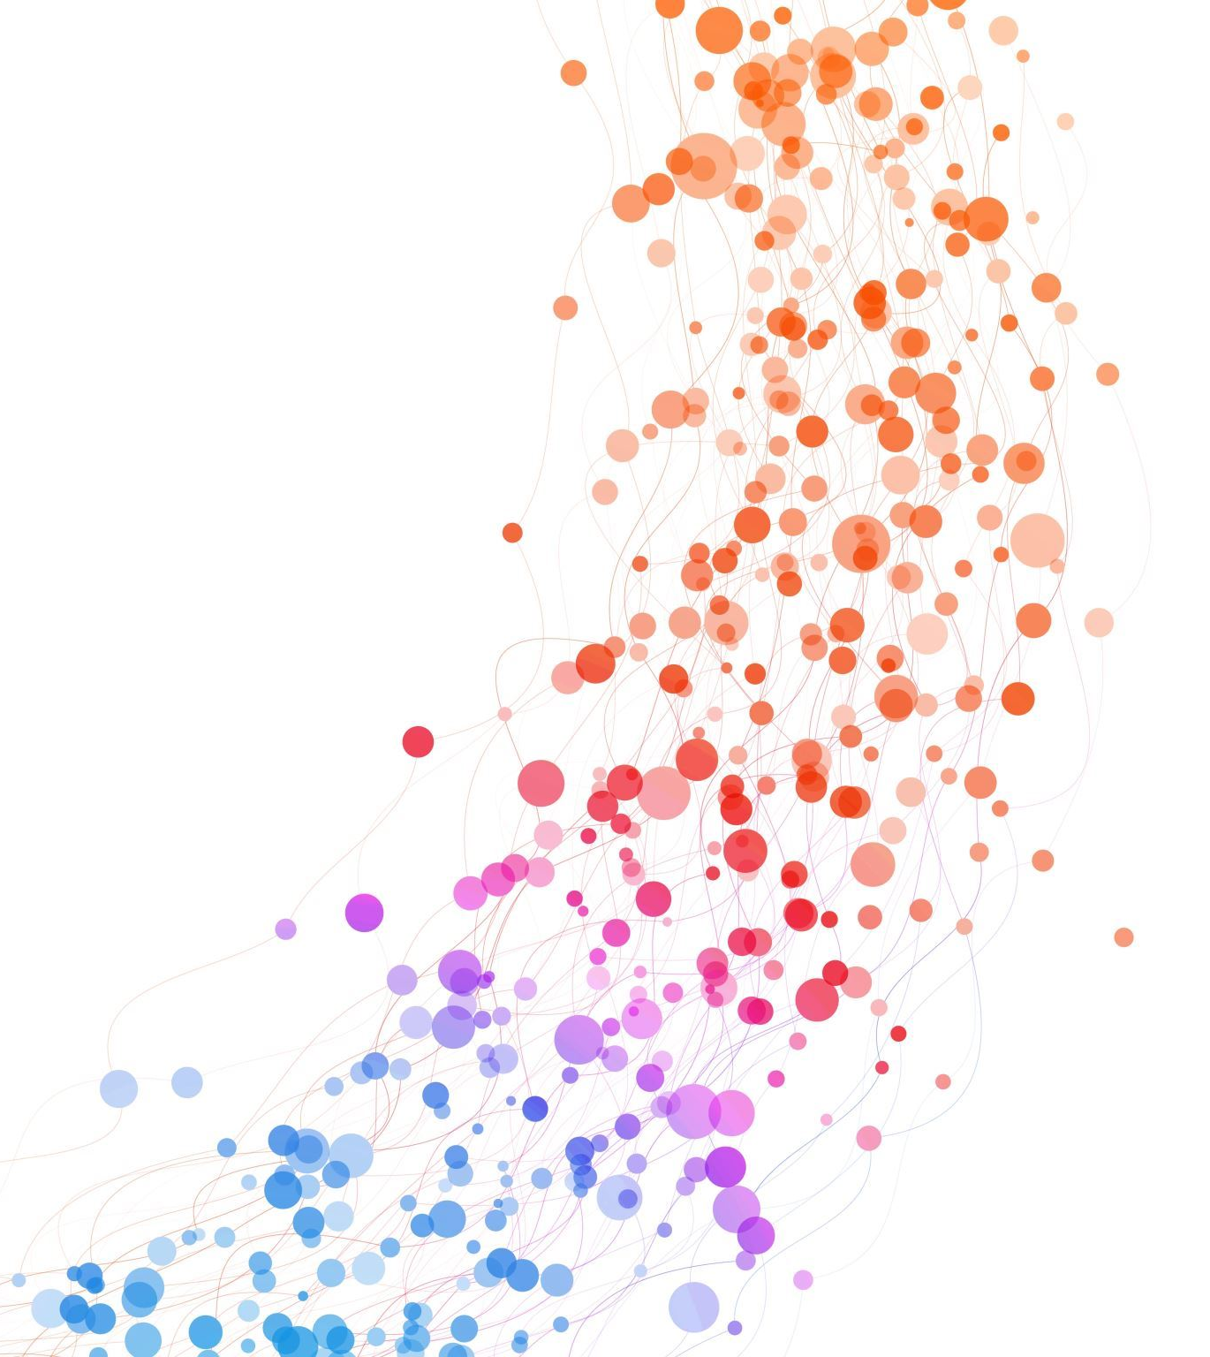
Development Team Members
Balaji Sukumaran (B00948977) bl664064@dal.ca
Tejas Pabbu (B00961226) tj970639@dal.ca
Hiteshkumar Gupta (B00954481) ht643276@dal.ca
Mayursinh Sarvaiya (B00918007) my343777@dal.ca
Shubham Dippakkumar Jethva (B00965783) sh526033@dal.ca

Slide 3
RentX
Rent X provides a localized platform for users to buy, rent, or sell items.
It offers affordable options during financial hardships, convenience for newcomers in a city, a comprehensive commerce solution, and an eco-friendly approach to reduce e-waste.
The platform also caters to trend-conscious consumers.
GitLab link: RentX
Project link: RentX

Slide 4
Dashboard Stats
Total Story Points Planned : 40
Story Points Achieved: 40
Completion rate : 100 %
Number of Given User Stories: 11
Sprint Duration : 2 weeks (Agile Methodology)
Milestones Accomplished : 4

Slide 5
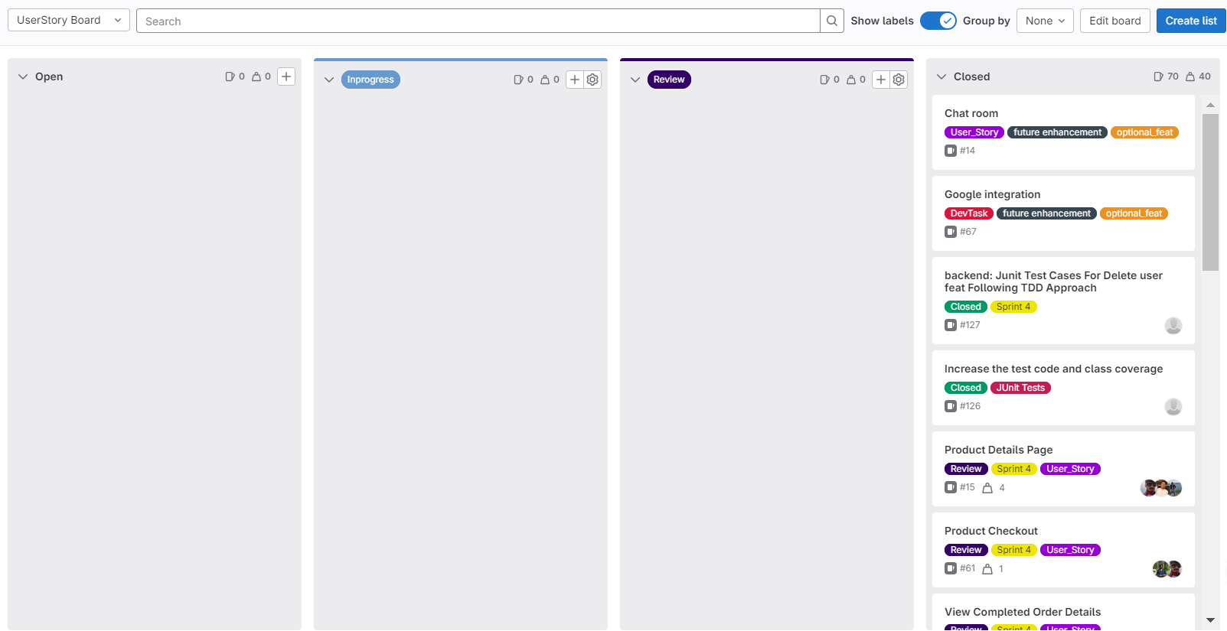
User Story Dashboard

Slide 6
Meeting Statistics
TA and Client Meetings : Occurs every Monday at 6:30 pm to 7:00 pm
Date | Place | Discussions (Demo) | Outcomes
Sep 25th, 2023 | Online | Tech stack Discussion. | TA Suggested to go by Sprint Boot backend
Oct 2nd, 2023 | Online | - Database Design demo. - Explained the project flow. | TA and Client were in agreement.
Oct 9th, 2023 | Online | - Authentication and registration using JWT. - Work on Profile and Advertisement API. - Client recommended forget password through email. | Dev team agreed to implement the feature next sprint
Oct 16th, 2023 | Online | - Home page completion. - Forget password through email. - Api created forgot password, Advertisement, Category, Purchase. | - TA and Client satisfied with Progress.
Oct 23rd, 2023 | Online | - Homepage and product details page completed. - Client suggested deploying application to VM. - TA Suggested follow TDD on upcoming commits. - Dev Team mentioned CI/CD and Deployment will be done by end of November 1st week. | - Dev team agreed to all suggestions. - Client and TA agreed to CI/CD and deployment of application in VM for Nov 1st week-end.

Slide 7
Meeting Statistics
TA and Client Meetings : Occurs every Monday at 6:30 pm to 7:00 pm
Date | Place | Discussions (Demo) | Outcomes
Oct 30th , 2023 | Online | - Wishlist Front End Demonstration - Seller Page and Product Category Demonstration | Suggestions given by Client on functionality UI
Nov 6th ,2023 | Online | - TDD Approach Tests Implementation of Previously Implemented API’s - Product Search Functionality Demonstrated | TA witnessed the TDD approach of development in action
Nov 13th , 2023 | Online | - Product Review Backend and Front End Integration - Code Deployment on VM | Client team able to access the website and hit and trial
Nov 20th , 2023 | Online | - Payment Gateway Demonstration - Stripes Dashboard Preview on Successful Payment - Show cased Final Test Coverage | - TA and Client satisfied with Progress.
Nov 27th , 2023 | Online | - Documentation Review - Final Project Demo infront of Client Team and TA’s | - TA and Client happy with the Project Presentation - Insights on Improvement

Slide 8
Detailed Story Point Stats
Sno | User Story | Story Points aLLOCATION | Contributors
1 | SignUp Page & Login page Creation | 3 | Mayursinh Sarvaiya Balaji Sukumaran Shubam Dipakkumar Jethva
2 | User Details/Settings | 3 | Tejas Pabbu Mayursinh Sarvaiya Shubham Dipakkumar Jethva Balaji Sukumaran
3 | DB_Design & Backend API Setup | 4 | Hiteshkumar Gupta Tejas Pabbu Balaji Sukumaran Shubham Dipakkumar Jethva
4 | Seller Page | 5 | Mayursinh Sarvaiya Hiteshkumar Gupta
5 | Product List by Category/Search | 4 | Mayursinh Sarvaiya Hiteshkumar Gupta
6 | Product Details Page | 4 | Tejas Pabbu Hiteshkumar Gupta Mayursinh Sarvaiya

Slide 9
Detailed Story Point Stats
Sno | User Story | Story Points aLLOCATION | Contributors
7 | Managing Wishlist Items | 6 | Mayursinh Sarvaiya Tejas Pabbu
8 | View Completed Order Details | 1 | Mayursinh Sarvaiya Balaji Sukumaran Tejas Pabbu Shubham Dipakkumar Jethva Hiteshkumar Gupta
9 | Checkout Popup | 4 | Mayursinh Sarvaiya Balaji Sukumaran Tejas Pabbu
10 | Product Checkout | 1 | Mayursinh Sarvaiya Balaji Sukumaran
11 | Home Page | 5 | Mayursinh Sarvaiya

Slide 10
Beyond User stories
Code quality & Code smell fixes
CI/CD Pipeline
Google cloud image setup
Stripe payment integration
Java Docs (comment)

Slide 11

Contribution Stats
Tejas – 20 %
Hitesh – 20%
Balaji – 20%
Mayur – 20%
Shubam – 20%

Slide 12
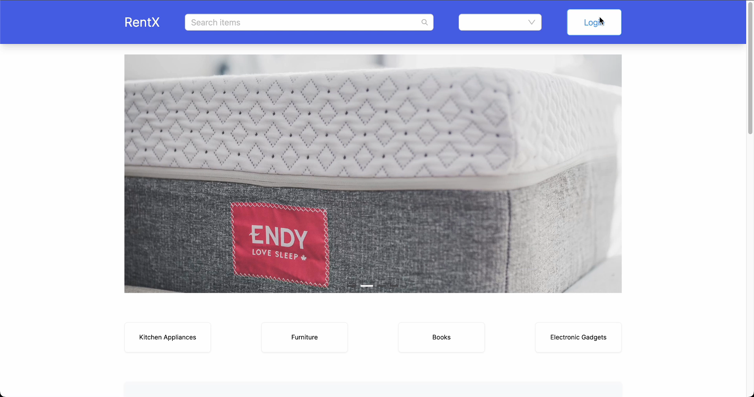
Project Demo

Slide 13
Project Status
Goal | Status
Authentication and Dashboard | Done
Product Catalogue and Product Detail Page | Done
Geographical Integration | Done
Booking and Payment Processing | Done
Stripe Payment Integration | Done
Test Driven Development Approach | Done
90% Code Coverage | Done
CI/CD Pipeline and VM deployment | Done
Code Smell Refactoring | Done

Slide 14
Hurdles Encountered
Differing Work Styles:
Managing diverse work styles and preferences within the team.
2. Timeline Pressures:
Dealing with time constraints and project deadlines.
3. Resource Allocation:
Allocating and utilizing team resources efficiently.
4. TDD Adoption Process:
Faced difficulty in beginning to adapt to TDD development
5. API Test Cases:
Challenging task to increase code coverage to 90 %

Slide 15
Learnings from project
Tech Stack:
Agile Methodology
Spring Boot
TDD
CI/CD
React
If given another opportunity to work on this project, we will:
Explore new efficient technologies to replicate the project
Follow the TDD approach from the start
Implement automated testing where applicable to catch issues early
Frequent code review and analysis
Synergize:
Diverse Skill Utilization
Conflict Resolution Strategies
Feedback Culture
Effective Time Management
Shared Accountability

Slide 16

Future Enhancement
Mobile App Development:
Develop a mobile application for RentX to make it more accessible to users on the go.
Ensure a seamless and user-friendly experience across different devices.
Integrated Messaging System (Chat Room) :
Enhance communication between buyers and sellers with an integrated messaging system.
Allow users to negotiate prices, discuss product details, and coordinate rental periods through the platform.

Slide 17
"Why buy the cow when you can rent the milk and change flavors?"
Use RentX!​

Slide 18

References
FB Marketplace - https://www.facebook.com/marketplace/
Olx.com - https://www.olx.com/
Rentomojo - https://www.rentomojo.com/
For images - https://unsplash.com/

